Slide 1

Relationship and Happiness
(A communication skill approach)
________________________________________
by
Dr. Vijai N. Giri
Professor of Communication Studies
Dept. of Humanities & Social Sciences
IIT Kharagpur
email: vng@hss.iitkgp.ernet.in

Slide 2
Why relationship?
_____________________________________
Necessary for survival: food, water, and
shelter
Necessary for feeling of safety.
Finally, individuals seek ‘more human
contacts’ which ultimately brings peace and
happiness.

Slide 3
Relationship and Happiness
  Relationships are the only thing that matter a lot in life.
  One could have a successful career, money and good physical health, but without supportive, loving relationships, one won’t be happy.
  So, the ability to build and maintain relationships is a great human skill.

Slide 4
Relationship and Happiness
Our earliest relationships are important to long-term happiness, especially the mother-child relationship.
Men who had a warm mother-child bond were less likely to develop dementia later in life.
They were also more likely to have professional success.

Slide 5
Communication and Happiness
Find ways to say "I love you" without saying "I love you.“
Communicate your feelings in a loving, constructive way as soon as circumstances permit.

Slide 6
Tips for communicators
❑ Relationships play an important role in our
life.
❑ There are several characteristics that help to
define relationships.
❑ Relationships influence our behaviour, goals,
and attitudes.
❑ The formulation of relationships depends on
communication.

Slide 7
Characteristics of a Relationship
• Relationships mold people.
• Relationships are subject to human problems.
• Relationships are transitory:
(a) Deep
(b) Moderate
(c) Casual
(d) Passing
Relationship rules cannot be formulated.

Slide 8
Characteristics of a Relationship
Relationship influence people.
(a) Goals
(b) Attitudes
(c) Behaviour
Relationships are activated through
communication.

Slide 9
Awareness
Acquaintance
Ground
breaking
Rapport
building
Mutual needs
not met
Relationship
ends
Exploration
Negotiation
Self-disclosure
Identification
Relationship
development
Breakdown

Slide 10
Stages in the Formation of a Relationship:
• Awareness
• Acquaintance
• Ground breaking
• Rapport building
• Exploration:
(a) Seeking information
(b) Giving information

Slide 11
Stages in the Formation of a Relationship
• Negotiation
• Self-disclosure:
(a)Formation of bonds
(b) Reduced need for further testing
• Identification:
(a) Efforts made to determine the partner’s needs.
(b) Efforts made to fulfil the partner’s needs.
• Breakdown

Slide 12
What do we look for in relationship?
• We look for someone like ourselves.
• We look for people who can do something for us.
• We look for someone who can help keep us in balance.
• We look for someone who is dynamic and sociable.

Slide 13
Exercise
Develop a list of ten most frequently occurring problems in relationships.
What relationship has had the greatest impact on your behaviour, attitudes and goals? Tell, briefly how this relationship has influenced you.

Slide 14
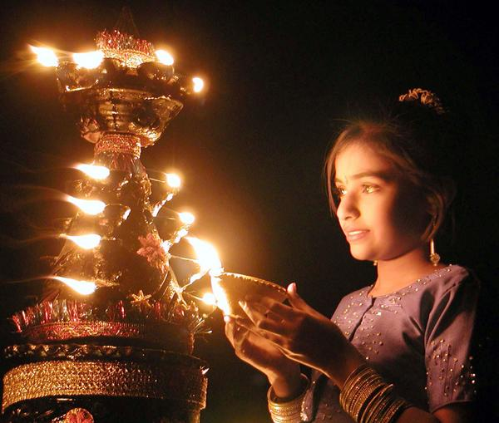
Thank You

